Slide 1
CSP571 Data Preparation and Analysis
Lecture 10. Unsupervised Learning
Oleksandr Narykov
onarykov@iit.edu

Slide 2
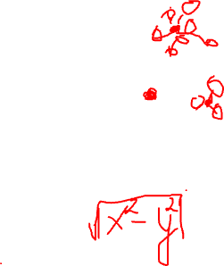
K-Means
Basic idea: given data, find k prototype vectors, and assign each data point to its closest prototype vector, such that the sum of the distances to the closest prototype vectors is minimized
𝑁
𝑗=1
Let 𝐷 = 𝑥
𝑘
𝑖=1
be the data and let 𝑚
be the
𝑗
𝑖
prototype vectors. Objective:
minimize ∑^{𝑁} min 𝑑𝑖𝑠𝑡𝑎𝑛𝑐𝑒 𝑥_{𝑗}, 𝑚_{𝑖}
𝑗=1
𝑖
A typical distance metric is Euclidan distance
5

Slide 3
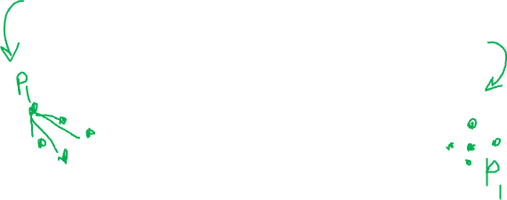
K-Means
Initialize k centers 𝑚_{𝑖}
𝑘
𝑖=1
Repeat until convergence
Assign each data point 𝑥_{𝑗} to the closest cluster center
Re-compute each center 𝑚_{𝑖}
𝑘
𝑖=1
as the mean of the
points that are assigned to that center
6

Slide 4
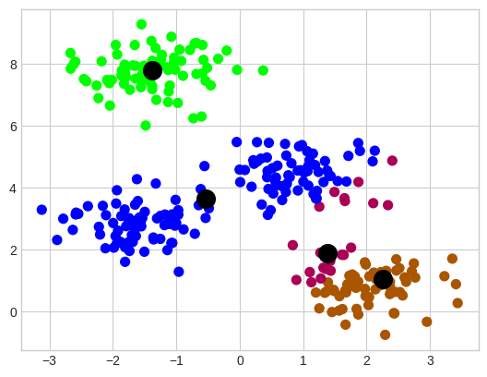
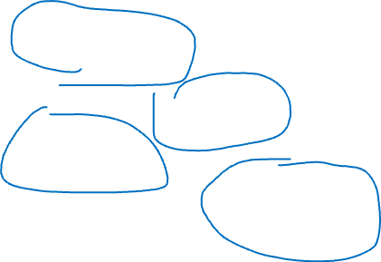
K-Means
Randomly initialized cluster centers
6

Slide 5
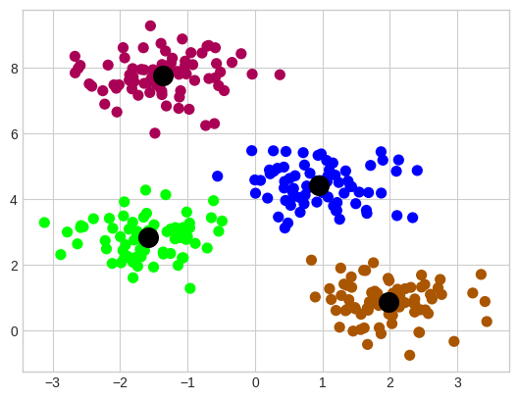
K-Means
Algorithm output after convergence (colors are changed)
6

Slide 6
K-Means
Algorithm output after convergence (colors are changed)
6

Slide 7
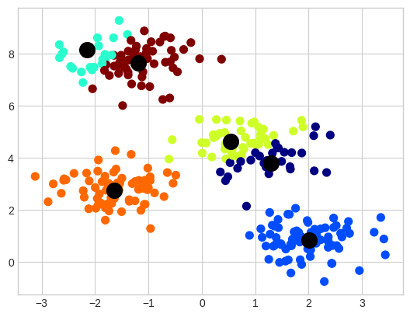

K-Means
Output of the K-Means with 6 clusters
6

Slide 8
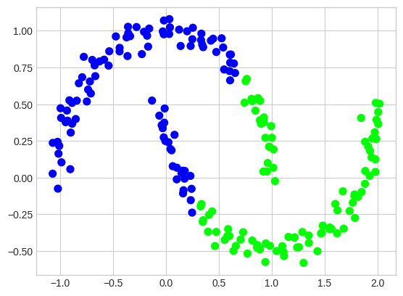
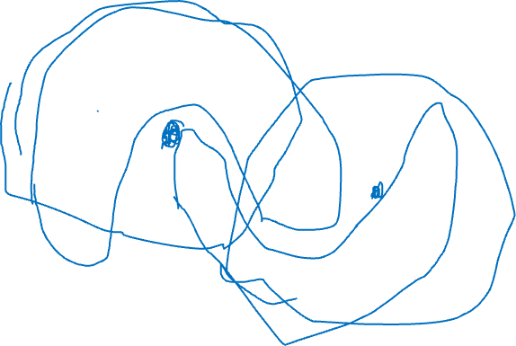
K-Means
Important assumption – clusters are convex
6

Slide 9
K-Means Summary
Guaranteed to converge in a finite number of iterations
Requires specifying the number of clusters beforehand
No guarantee for convergence to the global minimum
Output is highly dependent on the initial centroids
Sometimes, clusters can become empty
6

Slide 10
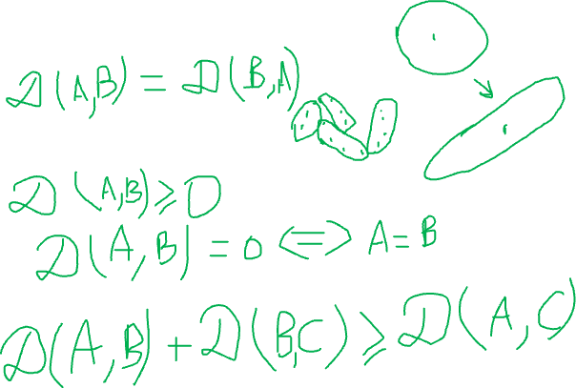
Generalizing Distance Measure
Symmetry
Positivity and self-similarity
Triangle inequality
6

Slide 11
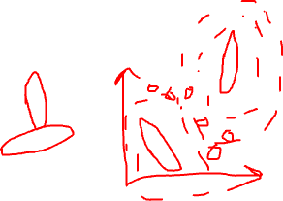
EM for Mixture of Gaussians
Basic idea: very much like the Bayes classifier where we have P(C) and p(x|C) and we use that for computing P(C|x), except, in this case, classes are not given to us. So, we take an iterative approach
Repeat until convergence
Assign data points to classes/centers/components probabilistically (i.e., compute P(C|x) using P(C) and p(x|C) ) – Expectation
Re-estimate class/center/component parameters based on the probabilistic assignments to classes/centers (i.e., recompute P(C) and p(x|C) using the probabilistic assignments) – Maximization
7

Slide 12
Notation
𝑃 𝐶_{𝑖} : prior probability of component 𝐶_{𝑖}
A multinomial distribution
𝑃 𝑥_{𝑗} 𝐶_{𝑖} : probability that component 𝐶_{𝑖} generated 𝑥_{𝑗}
A Gaussian distribution with mean 𝜇_{𝑖} and variance 𝜎²
𝑖
This can be easily generalized to multivariate Gaussian distribution with mean 𝜇_{𝑖} and co-variance Σ_{𝑖}
𝑃 𝐶_{𝑖} 𝑥_{𝑗} : probability that 𝑥_{𝑗} belongs to component 𝐶_{𝑖}
Via Bayes rule, 𝑃 𝐶_{𝑖} 𝑥_{𝑗} ∝ 𝑃 𝑥_{𝑗} 𝐶_{𝑖} 𝑃 𝐶_{𝑖}
𝑛_{𝑖}: Expected number of instances that belong to component 𝐶_{𝑖}
𝑛_{𝑖} = ∑^{𝑁} 𝑃 𝐶_{𝑖} 𝑥_{𝑗}
𝑗=1
8

Slide 13
EM
E step: compute cluster/component assignments
𝑃 𝐶_{𝑖} 𝑥_{𝑗} ∝ 𝑃 𝑥_{𝑗} 𝐶_{𝑖} 𝑃 𝐶_{𝑖}
M step: recompute parameters
𝑛_{𝑖} = ∑^{𝑁} 𝑃 𝐶_{𝑖} 𝑥_{𝑗}
𝑗=1
Weighted counts, where weights are 𝑃 𝐶_{𝑖} 𝑥_{𝑗}
𝑃 𝐶
₌ 𝑛_{𝑖}
𝑖
𝑁
𝑃 𝑥_{𝑗} 𝐶_{𝑖} ∼ Ν 𝜇_{𝑖}, 𝜎²
𝑖
∑𝑁
𝑃 𝐶 𝑥 𝑥_{𝑗}
𝜇_{𝑖} =
𝑗=1
𝑖 𝑗
𝑛
𝑖
Weighted mean, where weights are 𝑃 𝐶_{𝑖} 𝑥_{𝑗}
2
∑𝑁
𝑃 𝐶 𝑥 𝑥 −𝑚
𝑗=1
𝑖 𝑗
𝑗 𝑖
𝜎 ² =
𝑖
𝑛_{𝑖}
9
Weighted variance, where weights are 𝑃 𝐶_{𝑖} 𝑥_{𝑗}

Slide 14
EM
E step: compute cluster/component assignments
𝑃 𝐶_{𝑖} 𝑥_{𝑗} ∝ 𝑃 𝑥_{𝑗} 𝐶_{𝑖} 𝑃 𝐶_{𝑖}
M step: recompute parameters
𝑛_{𝑖} = ∑^{𝑁} 𝑃 𝐶_{𝑖} 𝑥_{𝑗}
𝑗=1
Weighted counts, where weights are 𝑃 𝐶_{𝑖} 𝑥_{𝑗}
𝑃 𝐶
₌ 𝑛_{𝑖}
𝑖
𝑁
𝑃 𝑥_{𝑗} 𝐶_{𝑖} ∼ Ν 𝜇_{𝑖}, 𝜎²
𝑖
∑𝑁
𝑃 𝐶 𝑥 𝑥_{𝑗}
𝜇_{𝑖} =
𝑗=1
𝑖 𝑗
𝑛
𝑖
Weighted mean, where weights are 𝑃 𝐶_{𝑖} 𝑥_{𝑗}
2
∑𝑁
𝑃 𝐶 𝑥 𝑥 −𝑚
𝑗=1
𝑖 𝑗
𝑗 𝑖
𝜎 ² =
𝑖
𝑛_{𝑖}
9
Weighted variance, where weights are 𝑃 𝐶_{𝑖} 𝑥_{𝑗}

Slide 15
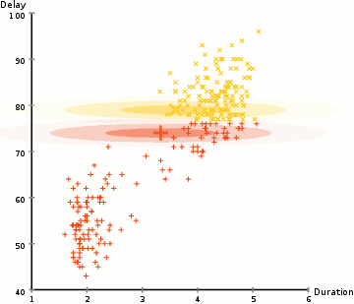
EM
https://upload.wikimedia.org/wikipedia/commons/6/69/EM_Clustering_of_Old_Faithful_data.gif
9

Slide 16
Hierarchical Clustering
Hierarchical versus Flat
Flat methods generate a single partition into k clusters.
The number k of clusters has to be determined by the user
ahead of time.
Hierarchical methods generate a hierarchy of partitions, i.e.
a partition P₁ into 1 clusters (the entire collection)
a partition P₂ into 2 clusters
…
a partition P_{n} into n clusters (each object forms its own cluster)
It is then up to the user to decide which of the partitions reflects
actual sub-populations in the data.
9
Partially based on https://www.stat.washington.edu/wxs/Stat593-s03/Slides/hierarchical-4-4-03.ppt

Slide 17
Hierarchical Clustering
Hierarchical versus Flat
Flat methods generate a single partition into k clusters.
The number k of clusters has to be determined by the user
ahead of time.
Hierarchical methods generate a hierarchy of partitions, i.e.
a partition P₁ into 1 clusters (the entire collection)
a partition P₂ into 2 clusters
…
a partition P_{n} into n clusters (each object forms its own cluster)
It is then up to the user to decide which of the partitions reflects
actual sub-populations in the data.
9

Slide 18
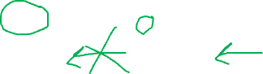
Hierarchical Clustering
P4
P3
P2
P1
Top: hierarchical sequence of partitions Bottom: non hierarchical sequence
9

Slide 19
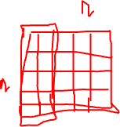
Agglomerative vs. Divisive
Agglomerative methods:
Start with partition P_{n}, where each object forms its own cluster.
Merge the two closest clusters, obtaining P_{n-1}.
Repeat merge until only one cluster is left.
Divisive methods
Start with P₁.
Split the collection into two clusters that are as homogenous (and as different from each other) as possible.
Apply splitting procedure recursively to the clusters.
9

Slide 20
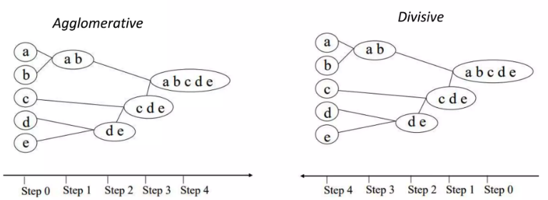
Agglomerative vs. Divisive
9

Slide 21
Hierarchical Clustering
Agglomerative methods:
A rule is required to decide which clusters to merge.
Typically, one defines a distance between clusters and then merges the two closest clusters.
Divisive methods
Divisive methods require a rule for splitting a cluster.
9

Slide 22
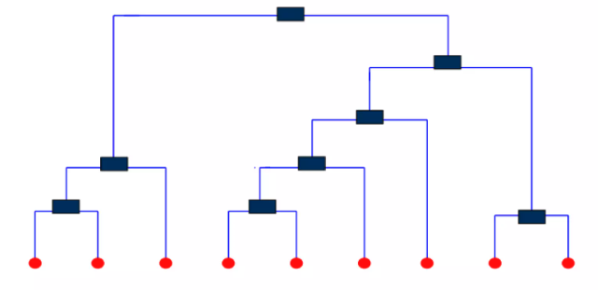
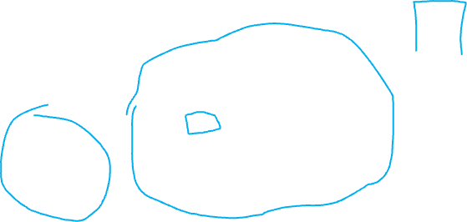
Dendrograms
Each node on the tree represents a cluster
Each leaf represents a singleton cluster
Highlights cluster hierarchy
9

Slide 23

Hierarchical Clustering Distances
Need to define a distance d(P,Q) between groups, given a distance measure d(x,y) between observations.
Commonly used distance measures:
1. d₁(P,Q) = min d(x,y), for x in P, y in Q ( single linkage )
2. d₂(P,Q) = ave d(x,y), for x in P, y in Q ( average linkage )
3. d₃(P,Q) = max d(x,y), for x in P, y in Q ( complete linkage )
4. ( centroid method )
5. ( Ward’s method )
9
d₅ is called Ward’s distance.

Slide 24
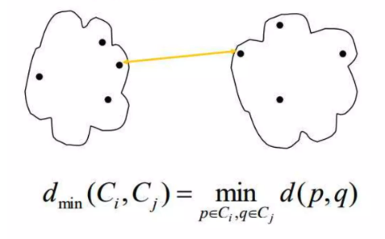
Single Link (Min Distance)
9

Slide 25
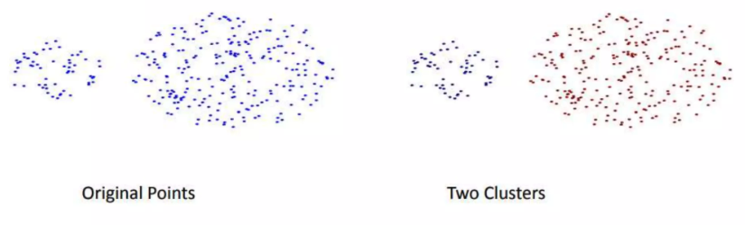
Single Link (Min Distance)
Pros:
Can handle non-elliptical shapes
9

Slide 26
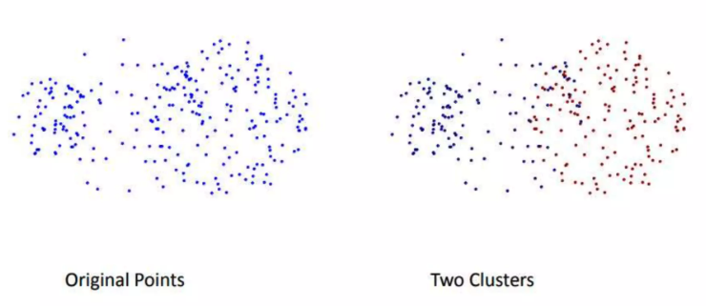
Single Link (Min Distance)
Cons:
Sensitive to noise and outliers
9

Slide 27
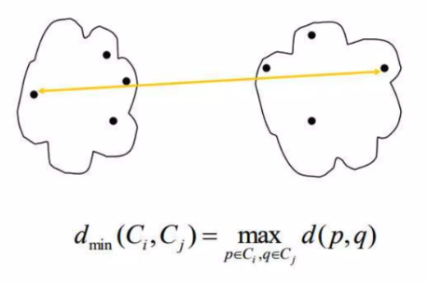
Complete Link (Max Distance)
9

Slide 28
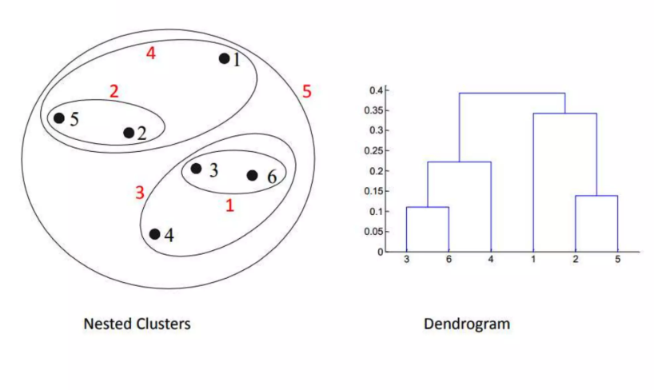
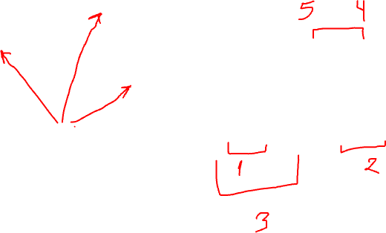
Complete Link (Max Distance)
9

Slide 29
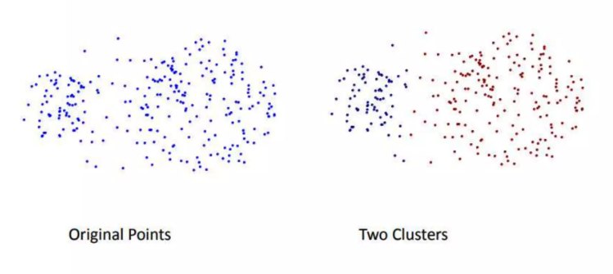
Complete Link (Max Distance)
Pros:
Less susceptible to noise and outliers
9

Slide 30
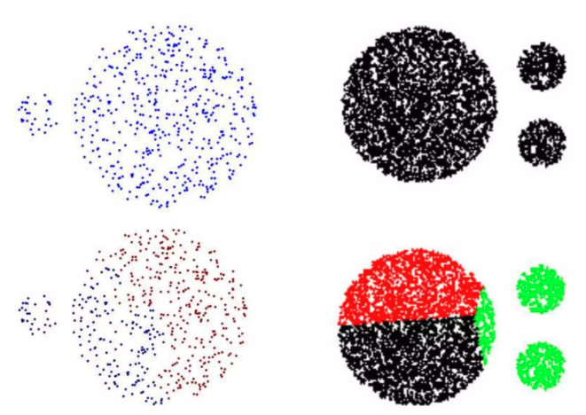
Complete Link (Max Distance)
Cons:
Tends to break large clusters
9

Slide 31
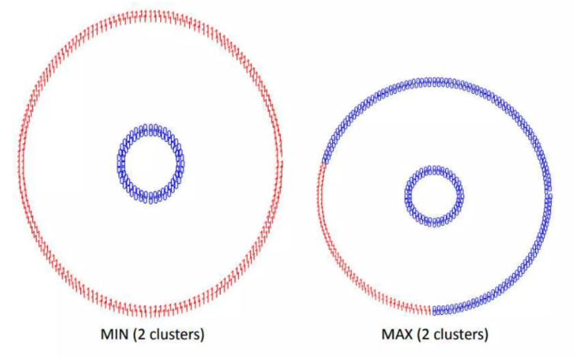
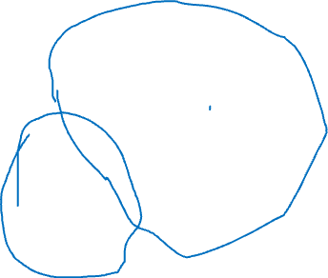
Complete Link (Max Distance)
Cons:
Tends to make globular clusters
9

Slide 32
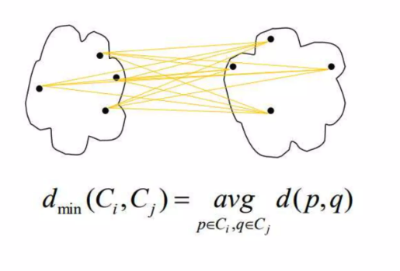
Average Link (Mean Distance)
9

Slide 33
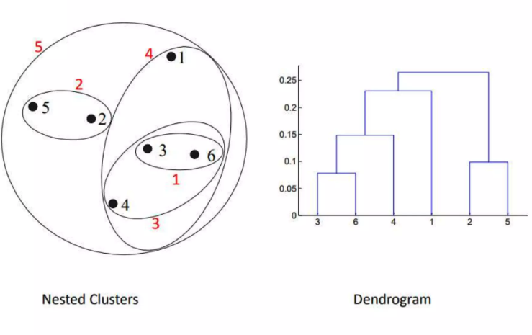
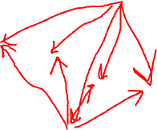
Average Link (Mean Distance)
9

Slide 34
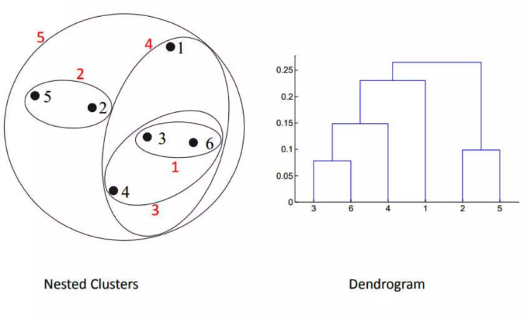
Average Link (Mean Distance)
Cons:
Tends to make globular clusters
9

Slide 35
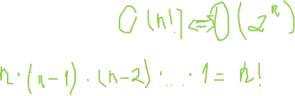
Ward’s Distance
Let Pk = P1 ,…, Pk be a partition of the observations into k groups.
Consider all possible (k-1)-partitions obtainable from Pk by a merge
Merging two clusters with the smallest Ward’s distance optimizes the goodness of the new partition.
9

Slide 36
Divisive Clustering
Compute a minimal spanning tree (graph connecting all the objects with the smallest total edge length)
Break the longest edge to obtain 2 subtrees and a corresponding partition of the objects.
Apply the process recursively to the subtrees
Agglomerative and divisive versions of single linkage give identical results
9

Slide 37
Divisive version of Ward’s method.
Given cluster R.
Need to find split of R into 2 groups P,Q to minimize
or, equivalently, to maximize Ward’s distance between P and Q.
9

Slide 38
Iterative search for the optimal Ward’s split
1. Project observations in R on the largest principal component.
2. Split at the median to obtain initial clusters P, Q.
3. Repeat until convergence
Assign each observation to cluster with the closest mean
Re-compute cluster means
Note:
Each step reduces RSS(P, Q)
No guarantee to find an optimal partition.
9

Slide 39
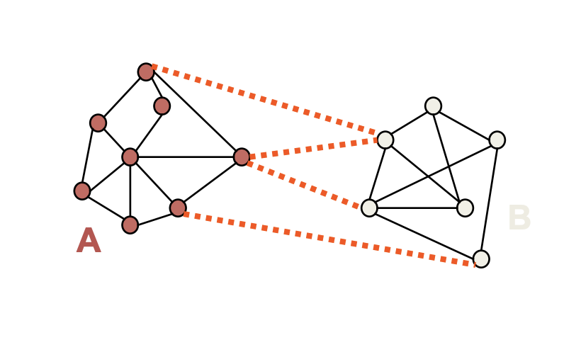
Spectral Clustering
EM and K-Means are limited by data shape assumptions
Potential solution: assign points that are close to each other to the same cluster
9

Slide 40
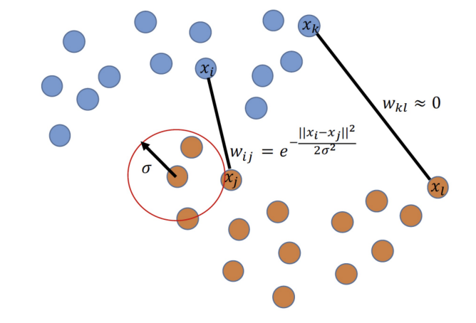
Spectral Clustering
Basic idea: group samples based graph communities
We need to construct a graph over datapoints
Similarity graph with a Gaussian kernel is a common approach
9

Slide 41
Spectral Clustering
Let’s separate the graph in two parts
Min-cut algorithm
Min-cut
Preferred cut
9

Slide 42
Spectral Clustering
Let’s separate the graph in two parts
Min-cut algorithm
Min-cut
Preferred cut
9

Slide 43
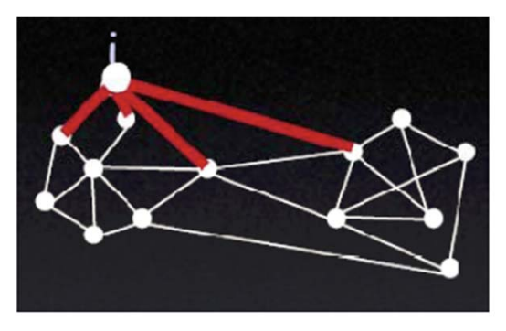
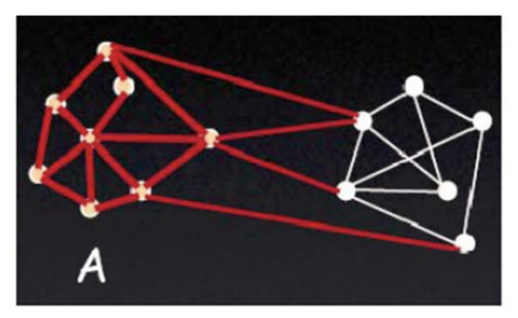
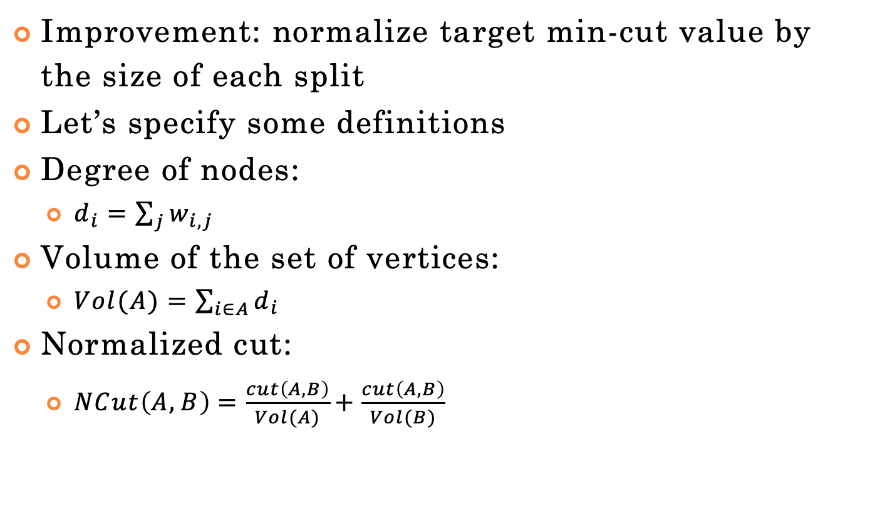
Spectral Clustering
Improvement: normalize target min-cut value by the size of each split
Let’s specify some definitions
Degree of nodes:
$d_{i}=\sum_{j}{w_{i,j}}$
Volume of the set of vertices:
$Vol(A)=\sum_{i∈A}{d_{i}}$
Normalized cut:
$NCut\left(A,B\right)=\frac{cut\left(A,B\right)}{Vol(A)}+\frac{cut\left(A,B\right)}{Vol(B)}$
https://people.csail.mit.edu/dsontag/
9

Slide 44
Spectral Clustering
Improvement: normalize target min-cut value by the size of each split
Let’s specify some definitions
Degree of nodes:
$d_{i}=\sum_{j}{w_{i,j}}$
Volume of the set of vertices:
$Vol(A)=\sum_{i∈A}{d_{i}}$
Normalized cut:
$NCut\left(A,B\right)=\frac{cut\left(A,B\right)}{Vol(A)}+\frac{cut\left(A,B\right)}{Vol(B)}$
https://people.csail.mit.edu/dsontag/
9

Slide 45
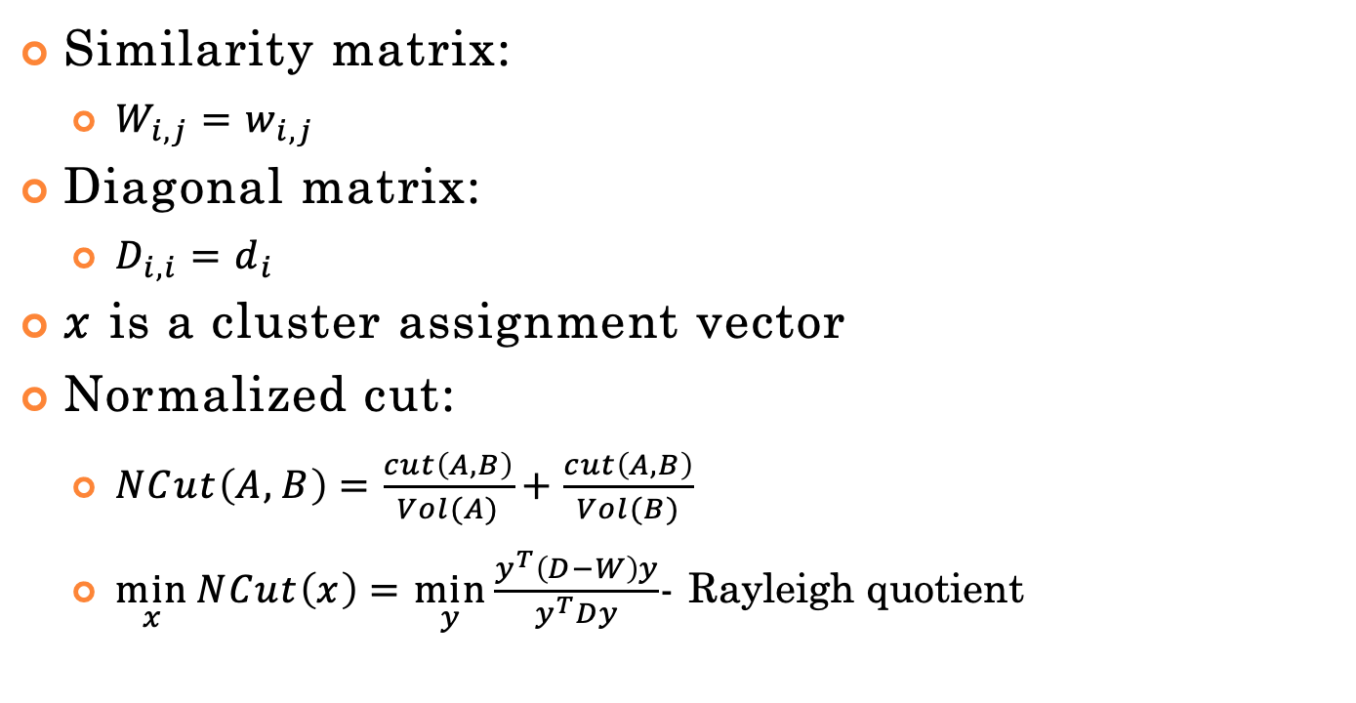
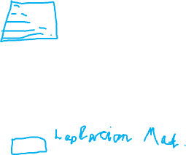
Spectral Clustering
Similarity matrix:
$W_{i,j}=w_{i,j}$
Diagonal matrix:
$x$ is a cluster assignment vector
Normalized cut:
$NCut\left(A,B\right)=\frac{cut\left(A,B\right)}{Vol(A)}+\frac{cut\left(A,B\right)}{Vol(B)}$
$\min_{x}{NCut\left(x\right)}=\min_{y}{\frac{y^{T}\left(D−W\right)y}{y^{T}Dy}}$- Rayleigh quotient
9

Slide 46
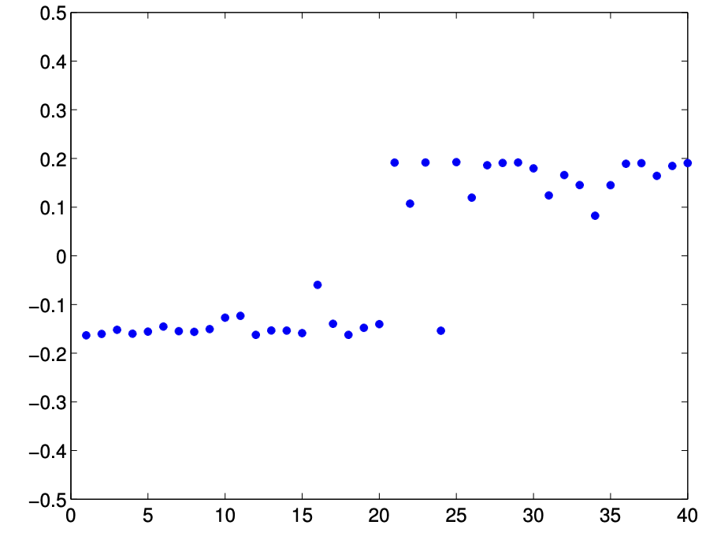
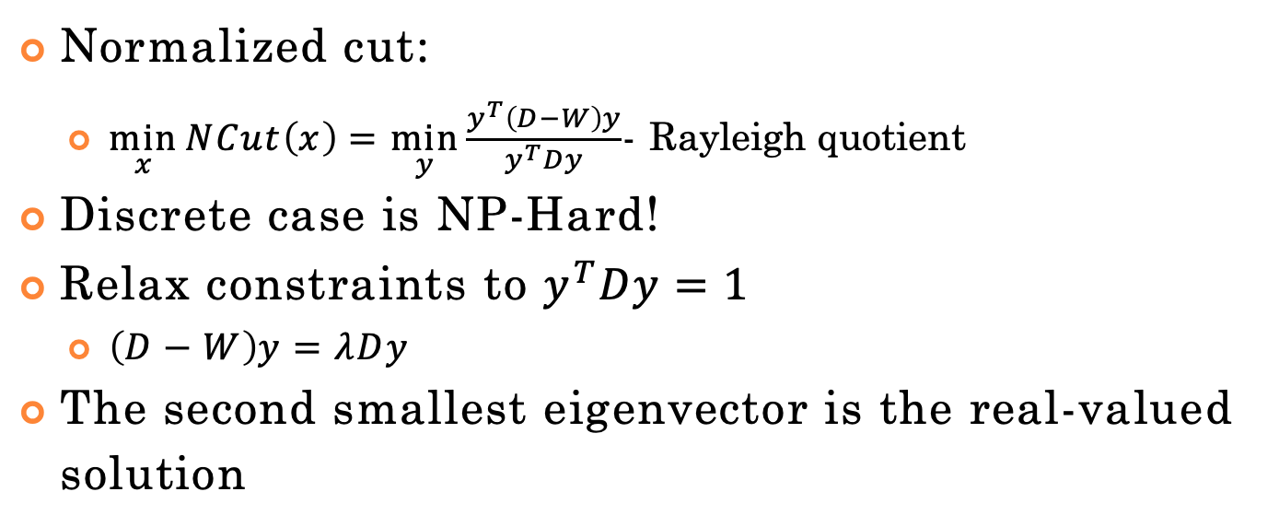
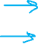
Spectral Clustering
Normalized cut:
$\min_{x}{NCut\left(x\right)}=\min_{y}{\frac{y^{T}\left(D−W\right)y}{y^{T}Dy}}$- Rayleigh quotient
Discrete case is NP-Hard!
Relax constraints to $y^{T}Dy=1$
$\left(D−W\right)y=λDy$
The second smallest eigenvector is the real-valued solution
9

Slide 47
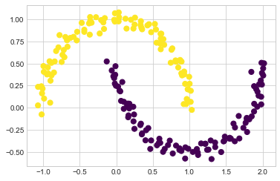
Spectral Clustering
9

Slide 48
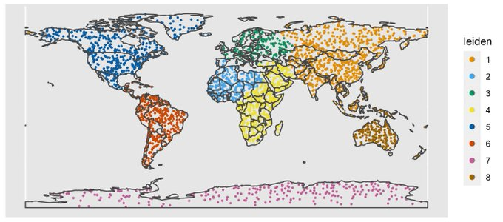
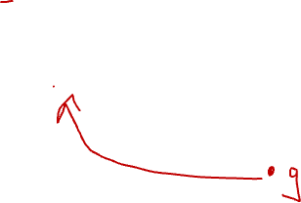
Leiden Clustering Example
https://github.com/lambdamoses/umap_globe
12

Slide 49
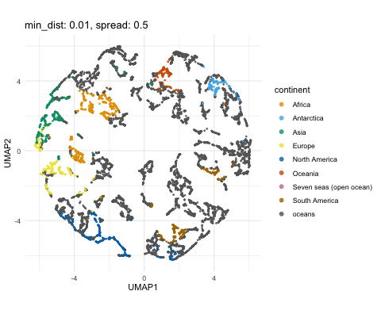
UMAP + Leiden Clustering Example
12
https://github.com/lambdamoses/umap_globe

Slide 50
Scikit-Learn
http://scikit- learn.org/stable/modules/clustering.html
10

